Slide 1


Heart Disease Prediction Using Machine Learning
Presented by: Shaik Ahmed Ali
SRM University – AP, Neerukonda, Mangalagiri Mandal, Guntur District, Andhra Pradesh
Course: Information Retrieval

Slide 2

The Crucial Need for Early Detection
Heart disease remains a leading cause of mortality worldwide. Early and accurate prediction is vital for timely medical intervention and ultimately, saving lives. Traditional diagnostic methods can often be slow and prone to human error, highlighting a critical gap that technology can address.
Objective
To develop a robust machine learning model capable of predicting heart disease risk from patient clinical data, thereby enhancing diagnostic efficiency and enabling proactive healthcare.

Slide 3

Understanding Our Data
Dataset Attributes
Target Output
Age, Sex, Chest Pain Type
The model's goal is to classify patients based on a binary outcome:
Resting Blood Pressure, Cholesterol, Fasting Blood Sugar
1 = Heart Disease Present
ECG, Max Heart Rate, Exercise Angina
Oldpeak, Slope, Ca (number of major vessels colored by fluoroscopy), Thal (thalassemia type)
0 = Not Present
Data Preprocessing
Standardization of numerical features
Tokenization and stop-word removal (if text features were present)
Data splitting: 80% for training, 20% for testing

Slide 4








Machine Learning Models Explored
We investigated a diverse array of machine learning algorithms, each offering unique strengths in pattern recognition and prediction.
Logistic Regression
Naive Bayes
A fundamental linear probability model, effective for binary classification.
A probabilistic classifier based on Bayes' theorem, assuming feature independence.
Support Vector Machine (SVM)
K-Nearest Neighbors (KNN)
Identifies the optimal hyperplane to separate classes effectively.
A non-parametric, instance-based learning algorithm that classifies based on proximity.
Decision Tree
Random Forest
A rule-based hierarchical structure that partitions data based on feature values.
An ensemble method leveraging multiple decision trees to enhance accuracy and reduce overfitting.
XGBoost
Neural Network (MLP)
A powerful gradient boosting framework optimized for speed and performance.
A multi-layer perceptron capable of learning complex, non-linear patterns in data.

Slide 5
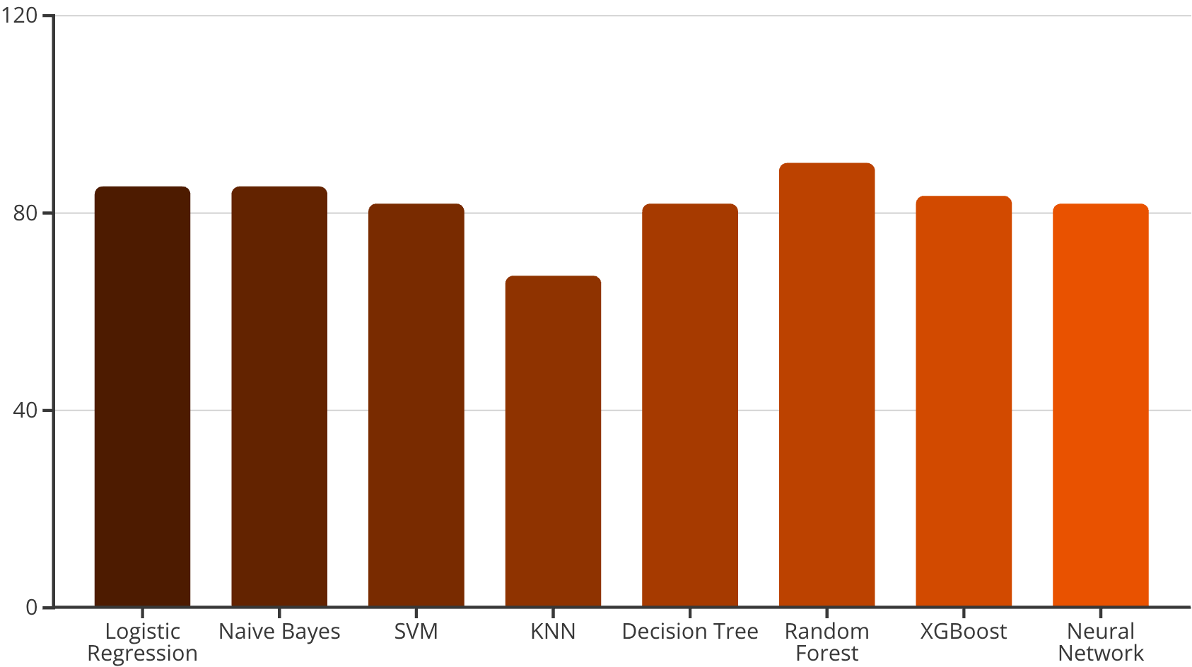
Performance Metrics: Model Accuracy Comparison
Logistic Regression
85.25%
Naive Bayes
85.25%
SVM
81.97%
KNN
67.21%
Decision Tree
81.97%
Random Forest
90.16%
XGBoost
83.61%
Neural Network
81.97%
The Random Forest model demonstrated superior performance, achieving the highest accuracy. Its ensemble approach effectively reduced overfitting and provided stable predictions even with a relatively smaller dataset.
The Neural Network's lower accuracy suggests that the current dataset size might be a limiting factor, or it requires more extensive hyperparameter tuning.

Slide 6




Conclusion & Future Directions
Our project successfully developed a machine learning model for heart disease prediction, with Random Forest emerging as the most effective algorithm.
1
2
Achieved 90.16% Accuracy
Deployment & Accessibility
The Random Forest model provides reliable early detection capabilities, significantly supporting healthcare decision-making.
Future work includes deploying the model as a user-friendly web or mobile application for broader access.
3
4
Dataset Expansion & Refinement
Real-time Integration
Increasing the dataset size and fine-tuning Neural Network hyperparameters are key next steps for enhanced performance.
Exploring integration with wearable devices to enable real-time heart health monitoring and prediction.
Thank You

